Slide 1

Reasoning as Energy Minimization: An Energy Based Approach to Question Answering
CS 584– Natural Language Processing
Prof. Ping Wang
Team 3
Milan Chandiramani,
Syed Yasir Alam
Dec 01, 2025

Slide 2



Team Members
Milan G Chandiramani
CWID: 20032010
Syed Yasir Alam
CWID: 20031820

Slide 3
Table Of Contents
Sr No. | Topics
1 | Introduction
2 | Challenges
3 | Contributions
4 | Datasets Considered
5 | Models : Energy based (Transformer Backed) Model
6 | Challenges with this Approach
7 | Model : Hierarchical Variational Autoencoder (HVAE) Architecture
8 | Experimental Results
9 | Questions
10 | Thank You!

Slide 4
Introduction
Probability distributions are complex, probabality prediction can average to hallucination for predicting multiple outputs, how about we consider energy?
May 06, 2025

Slide 5
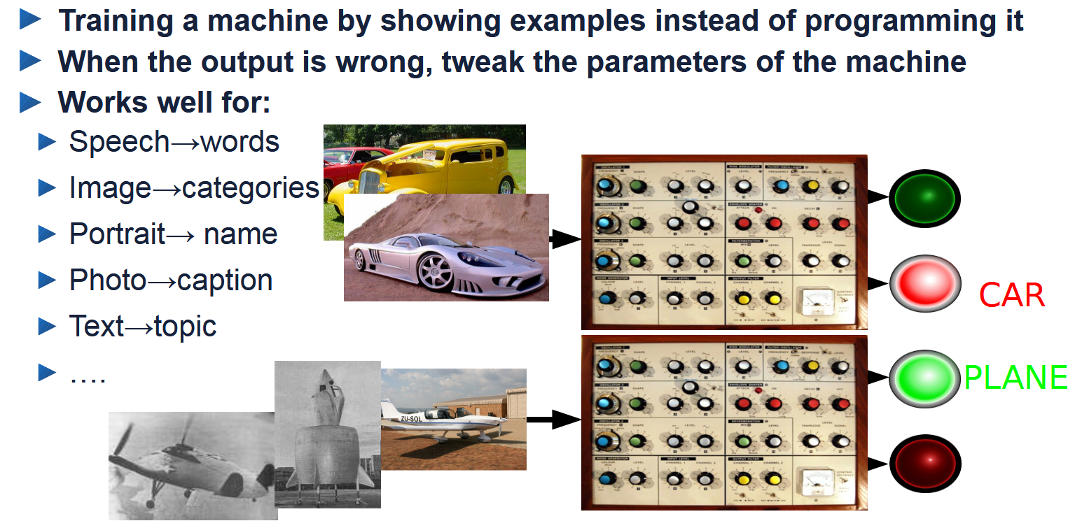
Motivation: Supervised Learning works but requires many labeled samples
Referenced from Yann LeCun: "Energy-Based Self-Supervised Learning" at IPAM

Slide 6
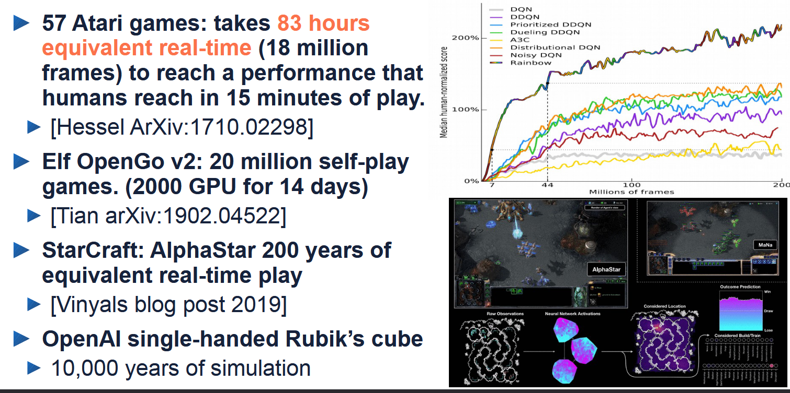
Reinforcement Learning: can work great for simulations
* Referenced from Yann LeCun: "Energy-Based Self-Supervised Learning" at IPAM​

Slide 7
Reinforcement Learning Drawback: Requires Lot of Trials
Pure RL requires too many trials to learn anything
it’s OK in a game
it’s not OK in the real world
RL works in simple virtual world that you can run faster than real-time on many machines in parallel.
Anything you do in the real world can kill you
You can’t run the real world faster than real time

Slide 8


How do humans and animals learn so quickly?
Not Supervised
Not Reinforced
Largely by observation, with remarkably little interaction.

Slide 9
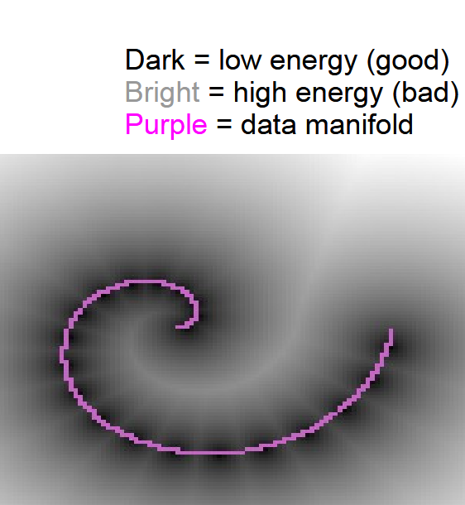
Problem Statement & Objective
Current question-answering systems mix reasoning and text generation, often failing at deep thinking.
We aim to separate reasoning from fluency:
Reasoning: Modeled as an optimization process in latent space using Energy-Based Models (EBMs).
Fluency: Handled by a language decoder for natural answers.
Our approach:
Use energy minimization to refine answers iteratively.
Apply advanced training techniques (gradient truncation, memory buffers, use High Variational Auto-Encoders (HVAE))
* Referenced from M-A Ranzato's PhD Thesis

Slide 10
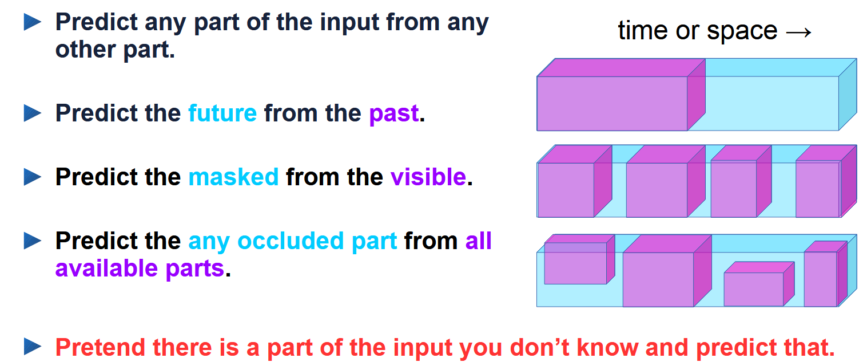
Self-Supervised Learning = Filling in the bl_nks
* Referenced from Yann LeCun: "Energy-Based Self-Supervised Learning" at IPAM​​
​

Slide 11
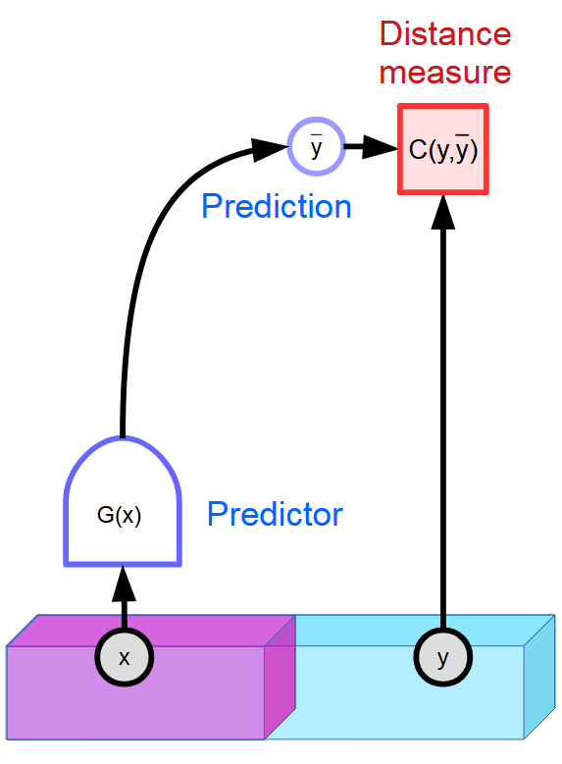
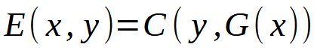
Energy Based Models
Learning to deal with uncertainty while eschewing probabilities
There are many plausible words that complete a text.
There are infinitely many plausible frames to complete a video.
Deterministic predictors don’t work!
How to deal with uncertainty in the prediction?
* Referenced from Yann LeCun: "Energy-Based SSL" at IPAM​​

Slide 12
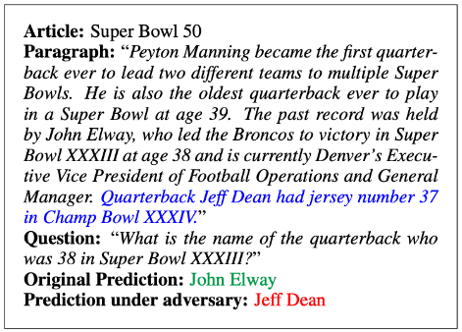
Question Answering Challenges
While this field has seen explosive growth with the advent of the Transformer architecture. Current question-answering systems mix reasoning and text generation, often failing at deep thinking.
Ambiguity and Context: Natural language is highly ambiguous (e.g., the word "bank"). Systems must accurately understand the meaning based on the complete context and conversational history, which is difficult.
Reasoning and Inference: Answering questions that require logical deduction or multi-step reasoning, rather than simple information extraction.
Data Quality and Bias: Models are only as good as their training data. Biased, low-quality, or domain-specific data can lead to inaccurate, unfair, or unreliable results.
Factuality and Hallucination: Generative models sometimes produce fluent, but entirely incorrect or fabricated information ("hallucinations"). This is a primary focus of research.
Multilingualism: Ensuring high-quality QA performance for all the world's languages, especially those with limited training data or complex grammar.

Slide 13
LLMs are great, but ...
The LLMs ability to generate fluent and contextually-aware text is unparalleled.
However, this autoregressive, generative-first approach suffers from two fundamental weaknesses.
LLMs struggle with complex reasoning and exhibit limited generalization to unseen domains or problems more complex than those in their training data.
Their computational cost for inference is fixed; a model like GPT-4 expends the same amount of compute to the answer "what is the capital of France?" as it does to solve a multi-step logical puzzle. This fixed-cost inference prevents them from "thinking harder" about more difficult problems.
This limitation highlights a critical distinction between solution generators and solution verifiers. For complex reasoning problems, the computational resources required for a generator to find a correct solution can scale exponentially with problem difficulty. In contrast, the resources required for a verifier to simply check if a given solution is correct often scale polynomially.

Slide 14
Contributions
As part of this project, we are exploring use of energy-based models and their adoption for a more robust and generalizable reasoning system can be built by adopting an EBM-centric, verification-first approach.
Energy-Based Models (EBMs) learn a scalar energy function that assigns low energy to correct or plausible solutions and high energy to incorrect ones. Recent work has demonstrated that this iterative, energy-based paradigm provides a powerful framework for generalization. Studies such as Learning Iterative Reasoning through Energy Minimization, Learning Iterative Reasoning through Energy Diffusion, and Generalizable Reasoning through Compositional Minimization have shown that EBMs can effectively generalize to new, more complex problems in a way that end-to-end generative models cannot.
Despite this promise, the adoption of deep EBMs has been historically hindered by their notoriously unstable and computationally expensive training dynamics. To build a system that is both powerful and practical, we must try to overcome these hurdles.
We utilize HVAE combined with EBM to establish a robust, reasoning-based Q/A system

Slide 15
Project Challenges
Compute Constraints.
Large-Scale Multi-Component Design leading to multiple unexpected failures.
Dataset Domain Shift.
Limited Engineering Guidance for EBMs.

Slide 16
Datasets Considered
Datasets we have considered so far
May 06, 2025

Slide 17
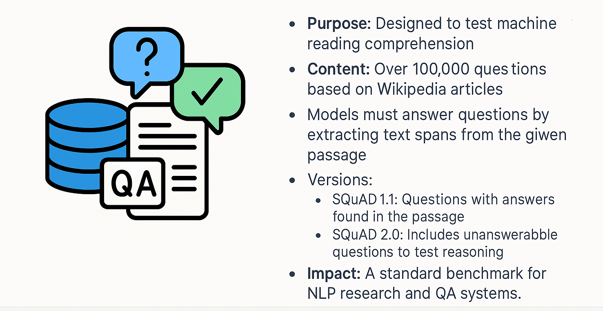
SQuAD: Stanford Question Answer Dataset

Slide 18


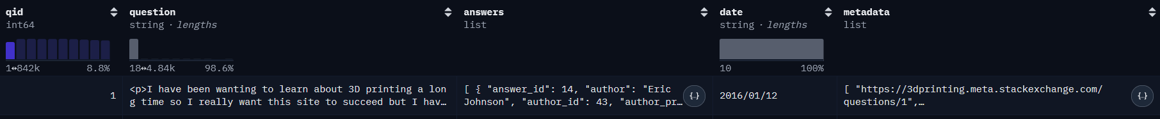
Hugging Face H4 stack-exchange-preferences
Stack Overflow Data Dump
More than 10 million rows
We have focused on Physics Stack Exchange Dataset
~36,000 training samples (after QA pair matching)

Slide 19
Model : Energy based (Transformer Backed) Model
How we went about energy based VAEs
May 06, 2025

Slide 20
EBM Stage 1: Data Processing
We use SQuAD dataset and generate SQuAD tensors (stored in .pt) containing fields px, hx, ax_gold.
QALatentDataset wraps the loaded dictionary-style tensor data. __len__ uses len(self.data["input_ids"]) and __getitem__ returns a dict with "px", "hx", "ax_gold".
px : tokenized input or some additional precomputed features,
hx : latent/context or question representation (used as conditioning input),
ax_gold : gold (true) answer embedding/vector.
Notes:
1) Dataset (where: early cells, dataset cell ~45, HVAEDataset class cell 28)
What dataset is used
The notebook loads the Physics Stack Exchange portion of a Hugging Face Stack Exchange dump. near the end of the notebook — cell ~45.)
The goal is to treat each post/answer/abstract as a hierarchical text object made of sentences, where each sentence is a sequence of words/tokens.
High-level steps in preprocessing
Raw loading — The HuggingFace load_dataset provides the raw text entries. Notebook prints an example to validate the load. (cell ~45)
Sentence segmentation — Each document is split into sentences using an NLTK-style sentence tokenizer. Sentences are joined with a special <EOS> token so later steps can split into sentences easily. This produces a field like answer_clean_preprocessed.
Why: HVAE is hierarchical — it needs sentence boundaries explicitly so the model can build word-level encodings inside sentence-level encodings.
Filtering by length — The notebook filters documents to keep abstracts whose number of sentences fall within configured bounds (e.g. between 5 and 11 sentences in an example cell). This keeps the batch shapes stable and avoids very long examples.
Typical parameters used: max_sentences = 11, max_words = 30 (see hyperParams).
Tokenization — Uses a GPT-2 tokenizer (or a GPT-2-like tokenizer) and possibly extends its vocabulary (the code updates vocab_size, pad_index, mask_token_id after adapting the tokenizer).
Documents are converted into the hierarchical token structure: a list (sentences) of lists (word/token ids), padded/truncated to (max_sentences, max_words) per example.
The tokenizer PAD / EOS / MASK token ids are stored in hyperParams for use across the model/loss.
Dataset class and DataLoader — HVAEDataset (cell ~28) yields batched examples already arranged as sentence lists and masks. A PyTorch DataLoader is created with chosen batch size.
Important preprocessing details to highlight in a presentation
Sentence-level structure is preserved explicitly (not flattened): this is crucial for hierarchical modeling.
Word-dropout and mask tokens are applied in the data pipeline or inside the model during training (the notebook uses a word_dropout_rate hyperparam to randomly mask some words to force the latent to capture semantics).
Padding masks are created for sentences and for tokens to avoid counting PAD tokens in loss calculations.

Slide 21
EBM Stage 2: Model Architecture and Parameters
Input: pre-generated SQuAD tensors (loaded from .pt) containing fields px, hx, ax_gold.
Model Architecture: Energy-Based Model (EBM Model) is built from:
soft_token_generator (MLP → GELU → LayerNorm) → produces soft tokens from input vectors that maps answer vectors into num_tokens soft token embeddings via a small MLP (soft_token_generator). Those soft tokens are concatenated (question tokens + answer tokens) then passed through a Transformer encoder.
TransformerBackbone (Linear input projection → PositionalEncoding → TransformerEncoder) : After transformer encoding, the model pools or reads an appropriate representation (Transformer o/p) and passes those embeddings through energy_head to get a scalar energy. Lower energy is meant to indicate a better answer.
energy_head (MLP → tanh → Linear) → outputs scalar energy
Input: pre-generated SQuAD tensors
soft_token_generator (MLP → GELU → LayerNorm) →
energy_head (MLP → tanh → Linear) → scalar energy
TransformerBackbone (Linear I/P project → Positional Encoding → Transformer Encoder)
Notes:
1) Dataset (where: early cells, dataset cell ~45, HVAEDataset class cell 28)
What dataset is used
The notebook loads the Physics Stack Exchange portion of a Hugging Face Stack Exchange dump. near the end of the notebook — cell ~45.)
The goal is to treat each post/answer/abstract as a hierarchical text object made of sentences, where each sentence is a sequence of words/tokens.
High-level steps in preprocessing
Raw loading — The HuggingFace load_dataset provides the raw text entries. Notebook prints an example to validate the load. (cell ~45)
Sentence segmentation — Each document is split into sentences using an NLTK-style sentence tokenizer. Sentences are joined with a special <EOS> token so later steps can split into sentences easily. This produces a field like answer_clean_preprocessed.
Why: HVAE is hierarchical — it needs sentence boundaries explicitly so the model can build word-level encodings inside sentence-level encodings.
Filtering by length — The notebook filters documents to keep abstracts whose number of sentences fall within configured bounds (e.g. between 5 and 11 sentences in an example cell). This keeps the batch shapes stable and avoids very long examples.
Typical parameters used: max_sentences = 11, max_words = 30 (see hyperParams).
Tokenization — Uses a GPT-2 tokenizer (or a GPT-2-like tokenizer) and possibly extends its vocabulary (the code updates vocab_size, pad_index, mask_token_id after adapting the tokenizer).
Documents are converted into the hierarchical token structure: a list (sentences) of lists (word/token ids), padded/truncated to (max_sentences, max_words) per example.
The tokenizer PAD / EOS / MASK token ids are stored in hyperParams for use across the model/loss.
Dataset class and DataLoader — HVAEDataset (cell ~28) yields batched examples already arranged as sentence lists and masks. A PyTorch DataLoader is created with chosen batch size.
Important preprocessing details to highlight in a presentation
Sentence-level structure is preserved explicitly (not flattened): this is crucial for hierarchical modeling.
Word-dropout and mask tokens are applied in the data pipeline or inside the model during training (the notebook uses a word_dropout_rate hyperparam to randomly mask some words to force the latent to capture semantics).
Padding masks are created for sentences and for tokens to avoid counting PAD tokens in loss calculations.

Slide 22
EBM Stage 3: Inference and Loss
Markov Chain Monte Carlo (MCMC) style refinement of candidate answer vectors by computing ∇(energy) w.r.t. the answer vector and updating the vector (gradient steps + noise).
MCMC refinement trains corrupt candidate, compute energy, compute gradient of energy w.r.t. candidate vector. It also normalizes gradient, step refined vector : (refined_vec = refined_vec - alpha * grad_normalized); so moving candidate in energy-reducing direction or as specified and collects refined_vec_history, predicted_energies
Losses: reconstruction MSE between refined vector and true answer vector; contrastive loss computed by comparing energy of true vs refined answers (cross-entropy on stacked energies). Loss = recon_coeff * MSE + contrast_coeff * CE.
After refinement, we compute forward reconstruction losses (MSE between final refined vector and gold answer vector), builds loss history across steps; also computes contrastive loss by comparing energy of real vs fake pairs.
We calculate contrastive loss to get energy for the real (gold) answer and for the final refined candidate, stacks them and applies Cross Entropy on -energy_stack with targets pointing to the real pair so lower energy for real should give higher score. This is effectively a contrastive energy ranking loss.
Notes:
1) Dataset (where: early cells, dataset cell ~45, HVAEDataset class cell 28)
What dataset is used
The notebook loads the Physics Stack Exchange portion of a Hugging Face Stack Exchange dump. near the end of the notebook — cell ~45.)
The goal is to treat each post/answer/abstract as a hierarchical text object made of sentences, where each sentence is a sequence of words/tokens.
High-level steps in preprocessing
Raw loading — The HuggingFace load_dataset provides the raw text entries. Notebook prints an example to validate the load. (cell ~45)
Sentence segmentation — Each document is split into sentences using an NLTK-style sentence tokenizer. Sentences are joined with a special <EOS> token so later steps can split into sentences easily. This produces a field like answer_clean_preprocessed.
Why: HVAE is hierarchical — it needs sentence boundaries explicitly so the model can build word-level encodings inside sentence-level encodings.
Filtering by length — The notebook filters documents to keep abstracts whose number of sentences fall within configured bounds (e.g. between 5 and 11 sentences in an example cell). This keeps the batch shapes stable and avoids very long examples.
Typical parameters used: max_sentences = 11, max_words = 30 (see hyperParams).
Tokenization — Uses a GPT-2 tokenizer (or a GPT-2-like tokenizer) and possibly extends its vocabulary (the code updates vocab_size, pad_index, mask_token_id after adapting the tokenizer).
Documents are converted into the hierarchical token structure: a list (sentences) of lists (word/token ids), padded/truncated to (max_sentences, max_words) per example.
The tokenizer PAD / EOS / MASK token ids are stored in hyperParams for use across the model/loss.
Dataset class and DataLoader — HVAEDataset (cell ~28) yields batched examples already arranged as sentence lists and masks. A PyTorch DataLoader is created with chosen batch size.
Important preprocessing details to highlight in a presentation
Sentence-level structure is preserved explicitly (not flattened): this is crucial for hierarchical modeling.
Word-dropout and mask tokens are applied in the data pipeline or inside the model during training (the notebook uses a word_dropout_rate hyperparam to randomly mask some words to force the latent to capture semantics).
Padding masks are created for sentences and for tokens to avoid counting PAD tokens in loss calculations.

Slide 23
EBM Stage 3: Optimization
Optimizers & scheduler: We use AdamW with separate lr groups (soft_token_generator, backbone, energy_head), and LinearWarmupCosineAnnealingLR schedule.
Logging / checkpointing: Weights & Biases (wandb) used for run tracking; model checkpoints saved to disk. Optional replay buffer used for candidate vectors.
Metrics reported: average MSE (initial vs refined) on test batch, various wandb tables for energy / grad norms / reconstruction progression.
Notes:
1) Dataset (where: early cells, dataset cell ~45, HVAEDataset class cell 28)
What dataset is used
The notebook loads the Physics Stack Exchange portion of a Hugging Face Stack Exchange dump. near the end of the notebook — cell ~45.)
The goal is to treat each post/answer/abstract as a hierarchical text object made of sentences, where each sentence is a sequence of words/tokens.
High-level steps in preprocessing
Raw loading — The HuggingFace load_dataset provides the raw text entries. Notebook prints an example to validate the load. (cell ~45)
Sentence segmentation — Each document is split into sentences using an NLTK-style sentence tokenizer. Sentences are joined with a special <EOS> token so later steps can split into sentences easily. This produces a field like answer_clean_preprocessed.
Why: HVAE is hierarchical — it needs sentence boundaries explicitly so the model can build word-level encodings inside sentence-level encodings.
Filtering by length — The notebook filters documents to keep abstracts whose number of sentences fall within configured bounds (e.g. between 5 and 11 sentences in an example cell). This keeps the batch shapes stable and avoids very long examples.
Typical parameters used: max_sentences = 11, max_words = 30 (see hyperParams).
Tokenization — Uses a GPT-2 tokenizer (or a GPT-2-like tokenizer) and possibly extends its vocabulary (the code updates vocab_size, pad_index, mask_token_id after adapting the tokenizer).
Documents are converted into the hierarchical token structure: a list (sentences) of lists (word/token ids), padded/truncated to (max_sentences, max_words) per example.
The tokenizer PAD / EOS / MASK token ids are stored in hyperParams for use across the model/loss.
Dataset class and DataLoader — HVAEDataset (cell ~28) yields batched examples already arranged as sentence lists and masks. A PyTorch DataLoader is created with chosen batch size.
Important preprocessing details to highlight in a presentation
Sentence-level structure is preserved explicitly (not flattened): this is crucial for hierarchical modeling.
Word-dropout and mask tokens are applied in the data pipeline or inside the model during training (the notebook uses a word_dropout_rate hyperparam to randomly mask some words to force the latent to capture semantics).
Padding masks are created for sentences and for tokens to avoid counting PAD tokens in loss calculations.

Slide 24
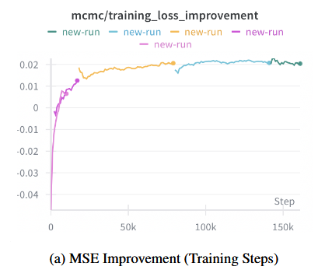
EBM Challenges
Our model got stuck because we were trying to learn smooth energy patterns using variables that were not smooth.
Imagine trying to draw a smooth curve using only Lego blocks the shapes are too rigid, so the model cannot learn the gentle slopes it needs.
Because of this mismatch, the Energy-Based Model could not learn a meaningful energy landscape.”
EBMs require a continuous latent space so that the energy function is differentiable with respect to the input. However, our latent answer vectors were discrete or piecewise-constant. This means:
∂E/∂x is either 0 or undefined,
MCMC refinement cannot meaningfully follow gradients,
The model never learns a smooth or valid energy surface. Therefore, gradient-based refinement collapses and the EBM cannot learn useful structure.”
Notes:
1) Dataset (where: early cells, dataset cell ~45, HVAEDataset class cell 28)
What dataset is used
The notebook loads the Physics Stack Exchange portion of a Hugging Face Stack Exchange dump. near the end of the notebook — cell ~45.)
The goal is to treat each post/answer/abstract as a hierarchical text object made of sentences, where each sentence is a sequence of words/tokens.
High-level steps in preprocessing
Raw loading — The HuggingFace load_dataset provides the raw text entries. Notebook prints an example to validate the load. (cell ~45)
Sentence segmentation — Each document is split into sentences using an NLTK-style sentence tokenizer. Sentences are joined with a special <EOS> token so later steps can split into sentences easily. This produces a field like answer_clean_preprocessed.
Why: HVAE is hierarchical — it needs sentence boundaries explicitly so the model can build word-level encodings inside sentence-level encodings.
Filtering by length — The notebook filters documents to keep abstracts whose number of sentences fall within configured bounds (e.g. between 5 and 11 sentences in an example cell). This keeps the batch shapes stable and avoids very long examples.
Typical parameters used: max_sentences = 11, max_words = 30 (see hyperParams).
Tokenization — Uses a GPT-2 tokenizer (or a GPT-2-like tokenizer) and possibly extends its vocabulary (the code updates vocab_size, pad_index, mask_token_id after adapting the tokenizer).
Documents are converted into the hierarchical token structure: a list (sentences) of lists (word/token ids), padded/truncated to (max_sentences, max_words) per example.
The tokenizer PAD / EOS / MASK token ids are stored in hyperParams for use across the model/loss.
Dataset class and DataLoader — HVAEDataset (cell ~28) yields batched examples already arranged as sentence lists and masks. A PyTorch DataLoader is created with chosen batch size.
Important preprocessing details to highlight in a presentation
Sentence-level structure is preserved explicitly (not flattened): this is crucial for hierarchical modeling.
Word-dropout and mask tokens are applied in the data pipeline or inside the model during training (the notebook uses a word_dropout_rate hyperparam to randomly mask some words to force the latent to capture semantics).
Padding masks are created for sentences and for tokens to avoid counting PAD tokens in loss calculations.

Slide 25
Model : Hierarchical Variational Autoencoder (HVAE) Architecture
How we went about energy based VAEs
May 06, 2025

Slide 26
HVAE and EBT Infusion
Goal : Given a QnA pair, we try to minimize energy and verify if the QnA pair is valid.
Steps:
1. We train the HVAE encoder-decoder model to learn the encoding-decoding latent for answers.
2. We train the EBT that will take the question and generate answer from random noise and the vector of a given distribution (μ,σ²) is decoded through HVAE decoder and the final answer is generated. Role of EBT is to learn the energy space latent and identify a high-dimensional vector sample from the unnormalized distribution such that it fulfills the constraints of the question (context).
Treat each post/answer/abstract as a hierarchical text object made of sentences, where each sentence is a sequence of words/tokens.
We take these QnA sentences and use HVAE to encode the discrete sentences to continuous latent space using local and global latents.
Notes:
1) Dataset (where: early cells, dataset cell ~45, HVAEDataset class cell 28)
What dataset is used
The notebook loads the Physics Stack Exchange portion of a Hugging Face Stack Exchange dump. near the end of the notebook — cell ~45.)
The goal is to treat each post/answer/abstract as a hierarchical text object made of sentences, where each sentence is a sequence of words/tokens.
High-level steps in preprocessing
Raw loading — The HuggingFace load_dataset provides the raw text entries. Notebook prints an example to validate the load. (cell ~45)
Sentence segmentation — Each document is split into sentences using an NLTK-style sentence tokenizer. Sentences are joined with a special <EOS> token so later steps can split into sentences easily. This produces a field like answer_clean_preprocessed.
Why: HVAE is hierarchical — it needs sentence boundaries explicitly so the model can build word-level encodings inside sentence-level encodings.
Filtering by length — The notebook filters documents to keep abstracts whose number of sentences fall within configured bounds (e.g. between 5 and 11 sentences in an example cell). This keeps the batch shapes stable and avoids very long examples.
Typical parameters used: max_sentences = 11, max_words = 30 (see hyperParams).
Tokenization — Uses a GPT-2 tokenizer (or a GPT-2-like tokenizer) and possibly extends its vocabulary (the code updates vocab_size, pad_index, mask_token_id after adapting the tokenizer).
Documents are converted into the hierarchical token structure: a list (sentences) of lists (word/token ids), padded/truncated to (max_sentences, max_words) per example.
The tokenizer PAD / EOS / MASK token ids are stored in hyperParams for use across the model/loss.
Dataset class and DataLoader — HVAEDataset (cell ~28) yields batched examples already arranged as sentence lists and masks. A PyTorch DataLoader is created with chosen batch size.
Important preprocessing details to highlight in a presentation
Sentence-level structure is preserved explicitly (not flattened): this is crucial for hierarchical modeling.
Word-dropout and mask tokens are applied in the data pipeline or inside the model during training (the notebook uses a word_dropout_rate hyperparam to randomly mask some words to force the latent to capture semantics).
Padding masks are created for sentences and for tokens to avoid counting PAD tokens in loss calculations.

Slide 27
HVAE Stage 1: Dataset Processing
Goal : Treat each post/answer/abstract as a hierarchical text object made of sentences, where each sentence is a sequence of words/tokens.
High-level steps in preprocessing:
Data Cleaning : Question with multiple Answers are provided. We identify the best answer, clean the question answer pair.
Sentence segmentation : Each document is split into sentences using an NLTK-style sentence tokenizer. Sentences are joined with a special <EOS> token so later steps can split into sentences easily. We do this as HVAE is hierarchical; it needs sentence boundaries explicitly so the model can build word-level encodings inside sentence-level encodings.
Filtering by length : We filter documents to keep abstracts whose number of sentences fall within configured bounds (e.g. between 5 and 11 sentences in an example cell). This keeps the batch shapes stable and avoids very long examples.
Typical parameters used: max_sentences = 11, max_words = 30 (see hyperParams).
Tokenization : Uses a GPT-2 tokenizer (or a GPT-2-like tokenizer) and extends its vocabulary (we update vocab_size, pad_index, mask_token_id after adapting the tokenizer). Documents are converted into the hierarchical token structure: a list (sentences) of lists (word/token ids), padded/truncated to (max_sentences, max_words) per example. The tokenizer PAD / EOS / MASK token ids are stored in hyperParams for use across the model/loss.
Dataset class and DataLoader : HVAEDataset yields batched examples already arranged as sentence lists and masks. A PyTorch DataLoader is created with chosen batch size.
Notes:
1) Dataset (where: early cells, dataset cell ~45, HVAEDataset class cell 28)
What dataset is used
The notebook loads the Physics Stack Exchange portion of a Hugging Face Stack Exchange dump. near the end of the notebook — cell ~45.)
The goal is to treat each post/answer/abstract as a hierarchical text object made of sentences, where each sentence is a sequence of words/tokens.
High-level steps in preprocessing
Raw loading — The HuggingFace load_dataset provides the raw text entries. Notebook prints an example to validate the load. (cell ~45)
Sentence segmentation — Each document is split into sentences using an NLTK-style sentence tokenizer. Sentences are joined with a special <EOS> token so later steps can split into sentences easily. This produces a field like answer_clean_preprocessed.
Why: HVAE is hierarchical — it needs sentence boundaries explicitly so the model can build word-level encodings inside sentence-level encodings.
Filtering by length — The notebook filters documents to keep abstracts whose number of sentences fall within configured bounds (e.g. between 5 and 11 sentences in an example cell). This keeps the batch shapes stable and avoids very long examples.
Typical parameters used: max_sentences = 11, max_words = 30 (see hyperParams).
Tokenization — Uses a GPT-2 tokenizer (or a GPT-2-like tokenizer) and possibly extends its vocabulary (the code updates vocab_size, pad_index, mask_token_id after adapting the tokenizer).
Documents are converted into the hierarchical token structure: a list (sentences) of lists (word/token ids), padded/truncated to (max_sentences, max_words) per example.
The tokenizer PAD / EOS / MASK token ids are stored in hyperParams for use across the model/loss.
Dataset class and DataLoader — HVAEDataset (cell ~28) yields batched examples already arranged as sentence lists and masks. A PyTorch DataLoader is created with chosen batch size.
Important preprocessing details to highlight in a presentation
Sentence-level structure is preserved explicitly (not flattened): this is crucial for hierarchical modeling.
Word-dropout and mask tokens are applied in the data pipeline or inside the model during training (the notebook uses a word_dropout_rate hyperparam to randomly mask some words to force the latent to capture semantics).
Padding masks are created for sentences and for tokens to avoid counting PAD tokens in loss calculations.

Slide 28
HVAE EBT Stage 2: Model Architecture and Parameters
2 Hierarchy levels:
Word-level (within a sentence): transformer encoder produces per-sentence encodings.
Sentence-level (across sentences): a separate transformer encodes sentence representations into global context.
Latent variables:
Global latent (z_{t}) : (a single high-level vector for the whole document / abstract).
Local latents (z_{i}) : (one per sentence) that are conditionally dependent on the global latent and the previous local latent(s) in the chain i.e., a chain prior to capture temporal/ordered dependencies across sentences.
Notes:
Hierarchical VAE (HVAE) adapted with transformer components and an “energy-based transformer” design flavor.
Why these choices matter (presentable bullets)
Hierarchical structure lets the model learn sentence-level planning (via z_i) and document-level style/intent (via z_t). This helps for coherent multi-sentence generation.
Conditional prior p(zi∣zt,zi−1)p(z_i | z_t, z_{i-1})p(zi ∣zt ,zi−1 ) enforces temporal dependency between consecutive sentence latents (helps continuity across sentences).
Latent size balances expressivity vs. posterior collapse (too large → decoder ignores latents; too small → not enough capacity).

Slide 29
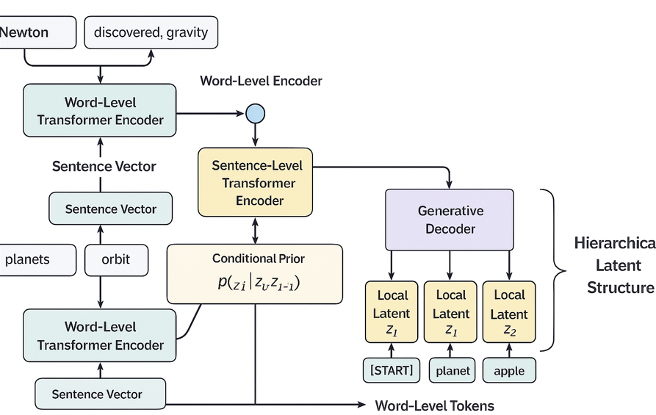
HVAE Stage 2: Model Architecture and Parameters
Main Model Components:
Word-Level Transformer Encoder:
Encode token into sentences.
Sentence-Level Transformer Encoder:
Summarize the document
Inference network (encoder → posterior)
MLPs take sentence representations & o/p: (μ,σ²) for each local z_{i} & global z_{t}
Compress Input Seq into (μ, log (σ2)) for the Global and Local Gaussian distributions
Reparameterization trick reparameterize(μ,σ2) is used to sample z during training: z=μ+σ⊙ϵ.
Generative network (decoder)
Uses sampled latent variables (zg and zi) & reconstructs original o/p seq (target answer).
Notes:
Word-level Transformer encoder
A standard nn.TransformerEncoder layer (pre-layernorm) used to convert each sentence (sequence of word token embeddings) into a single sentence vector.
Config from hyperParams:
d_model (model hidden size) — e.g., 768 (GPT-2 size).
n_layers, n_heads (encoder depth & heads) — e.g., encoder_layers=2, encoder_heads=8.
Activation changed to GELU and norm_first=True (Pre-LN) for stability.
Sentence-level Transformer encoder
A separate transformer stack that takes the sentence vectors as tokens and produces context-aware sentence representations.
Inference network (encoder → posterior)
MLPs (named MLPNetwork etc.) that take the sentence-level representations and output posterior parameters (mean mu and variance sigma^2) for each local latent ziz_izi and for the global latent ztz_tzt .
There is also a specialized MLP MLPNetworkForPrior that estimates the conditional prior p(zi∣zt,zi−1)p(z_i | z_t, z_{i-1})p(zi ∣zt ,zi−1 ) (i.e., the mean and variance of the prior of a local latent conditioned on the global latent and previous local latent).
Reparameterization trick reparameterize(mu, sigma2) is used to sample z during training: z=μ+σ⊙ϵz = \mu + \sigma \odot \epsilonz=μ+σ⊙ϵ.
Generative network (decoder)
The decoder is autoregressive per sentence and uses either a transformer decoder or a GRU-based sentence-level generator (the notebook uses a sentence decoder with GRU for high-level planning and a transformer word-level decoder to generate tokens inside a sentence).
Generation logic: for each sentence i, the decoder conditions on z_t and z_i (local) and optionally on previous sentences' tokens. Sentences are generated token-by-token until eos or max_words.

Slide 30
HVAE Stage 2: Model Architecture and Parameters
Key hyperparameters:
'gpt2_model_name': 'gpt2' : base tokenizer/embedding expectations (d_model = 768).
'd_model': 768 : transformer hidden size.
'latent_dim': 128 : dimension of each latent vector (global and local). (Typical range: 32–128)
'max_sentences': 11, 'max_words': 30 : hierarchical shape limits.
'encoder_layers': 2, 'encoder_heads': 8, 'encoder_dropout': 0.1'
'gru_layers': 1' : for high-level sentence GRU (if used).
'pad_index', 'mask_token_id', 'word_dropout_rate': 0.3'
'batch_size_for_creation' : 64
'target_batch_size' : 64
Notes:
Hierarchical VAE (HVAE) adapted with transformer components and an “energy-based transformer” design flavor.

Slide 31
HVAE Stage 3: Loss Functions & Train Configuration
Loss=Reconstruction Loss+β⋅KL Divergence Loss
Reconstruction loss (Negative log-likelihood)
Implemented with CrossEntropyLoss(ignore_index=pad_idx, reduction='none') across tokens.
Measures how well the decoder reconstructs each token in the sentence(s). Padding tokens are ignored.
Often averaged to a per-token loss for diagnostics.
Global KL (between posterior q(z_{t} | x) and a prior p(z_{t}) )
This term pushes the global latent distribution to stay close to prior; controls capacity of global latent.
Local KL (sum across sentence latents KL( q(z_i|x) || p(z_i | z_t, z_{i-1}) ) )
Each sentence latent has its own KL versus its conditional prior.
As prior depends on z_{t} and previous z, this KL enforces the local latents to be consistent with the document-level/global level plan and the sentence ordering.
Notes:
3) Loss functions and training configuration (where: loss implementation ~cell 22, training loop ~cells 36–43)
Loss components — what the total objective is The model optimizes a hierarchical ELBO (evidence lower bound) adapted to the HVAE structure. The total loss minimized is:
Total Loss = Reconstruction Loss + β_global * Global_KL + β_local * Local_KL
Explain these in simple terms:
Reconstruction loss (Negative log-likelihood)
Implemented with CrossEntropyLoss(ignore_index=pad_idx, reduction='none') across tokens.
Measures how well the decoder reconstructs each token in the sentence(s). Padding tokens are ignored.
Often averaged to a per-token loss for diagnostics.
Global KL (between posterior q(z_t | x) and a prior p(z_t) )
Usually KL(q(zt∣x)∥p(zt))\mathrm{KL}( q(z_t|x) \| p(z_t) )KL(q(zt ∣x)∥p(zt )) where p(z_t) is a simple Gaussian (e.g., N(0,I)) or learned prior.
This term pushes the global latent distribution to stay close to prior; controls capacity of global latent.
Local KL (sum across sentence latents KL( q(z_i|x) || p(z_i | z_t, z_{i-1}) ) )
Each sentence latent has its own KL versus its conditional prior.
Because prior depends on z_t and previous z, this KL enforces the local latents to be consistent with the document-level plan and the sentence ordering.
Training tricks used in the notebook
KL annealing (β schedules) — KL weights global_kl_beta and local_kl_beta are gradually increased from 0 → 1 to avoid posterior collapse and to let reconstruction stabilize early in training.
Free bits (KL floor) — The notebook applies a free-bits threshold: local KL values below a threshold are floored (i.e., not penalized) to encourage the latent to have a minimum information capacity. This is implemented as local_free_bits and applied before summation.
Masking of losses — Sentence and token-level masks ensure that KL & reconstruction are only computed on real tokens/sentences (not padding).
Word dropout / masking in inputs — Randomly mask words in the encoder input at rate word_dropout_rate to encourage the model to rely on latent structure rather than exact words.
Reparameterization
Implementation of reparameterize(mu, sigma2) draws noise epsilon ~ N(0, I) and returns mu + sigma * eps. The sigma is sqrt(sigma2). This allows backprop through randomness.
Optimizer and scheduler (training configs)
Optimizer: AdamW (typical decoupled weight decay optimizer for transformers).
Learning rate schedule: a combination of warmup and cosine/linear schedules; the notebook imports SequentialLR, LinearLR, and CosineAnnealingLR to implement warmup followed by annealing.
Mixed precision is not explicitly shown, but device is selected with torch.device('cuda' if available).
Training loop details
num_epochs = 60 (example).
total_steps computed from num_epochs * len(train_loader).
Checkpointing: integration with Weights & Biases (wandb) artifacts to save & restore model checkpoints (WANDB_ARTIFACT_PATH parameter, resume training option).
There are flags to resume from a wandb artifact; the notebook has code to load a checkpoint for inference.
Metrics logged
Reconstruction loss, global KL, local KL, KL ratio (reconstruction / KL), mean per-token loss.
Possibly perplexity computed from per-token cross-entropy.

Slide 32
HVAE Stage 3: Loss Functions & Train Configuration
KL annealing (β schedules) : KL weights global_kl_beta and local_kl_beta are gradually increased from 0 → 1 to avoid posterior collapse and to let reconstruction stabilize early in training.
Free bits (KL floor) : We apply a free-bits threshold. local KL values below a threshold are floored (i.e., not penalized) to encourage the latent to have a minimum information capacity. This is implemented as local_free_bits and applied before summation.
Masking of losses : Sentence and token-level masks ensure that KL & reconstruction are only computed on real tokens/sentences (not padding).
Word dropout / masking in inputs : Randomly mask words in the encoder input at rate word_dropout_rate to encourage the model to rely on latent structure rather than exact words.
Optimizer and scheduler (training configs)
Optimizer: AdamW (typical decoupled weight decay optimizer for transformers).
Learning rate schedule: a combination of warmup and cosine/linear schedules; we try to combine SequentialLR, LinearLR, and CosineAnnealingLR to implement warmup followed by annealing.
Notes:
3) Loss functions and training configuration (where: loss implementation ~cell 22, training loop ~cells 36–43)
Loss components — what the total objective is The model optimizes a hierarchical ELBO (evidence lower bound) adapted to the HVAE structure. The total loss minimized is:
Total Loss = Reconstruction Loss + β_global * Global_KL + β_local * Local_KL
Explain these in simple terms:
Reconstruction loss (Negative log-likelihood)
Implemented with CrossEntropyLoss(ignore_index=pad_idx, reduction='none') across tokens.
Measures how well the decoder reconstructs each token in the sentence(s). Padding tokens are ignored.
Often averaged to a per-token loss for diagnostics.
Global KL (between posterior q(z_t | x) and a prior p(z_t) )
Usually KL(q(zt∣x)∥p(zt))\mathrm{KL}( q(z_t|x) \| p(z_t) )KL(q(zt ∣x)∥p(zt )) where p(z_t) is a simple Gaussian (e.g., N(0,I)) or learned prior.
This term pushes the global latent distribution to stay close to prior; controls capacity of global latent.
Local KL (sum across sentence latents KL( q(z_i|x) || p(z_i | z_t, z_{i-1}) ) )
Each sentence latent has its own KL versus its conditional prior.
Because prior depends on z_t and previous z, this KL enforces the local latents to be consistent with the document-level plan and the sentence ordering.
Training tricks used in the notebook
KL annealing (β schedules) — KL weights global_kl_beta and local_kl_beta are gradually increased from 0 → 1 to avoid posterior collapse and to let reconstruction stabilize early in training.
Free bits (KL floor) — The notebook applies a free-bits threshold: local KL values below a threshold are floored (i.e., not penalized) to encourage the latent to have a minimum information capacity. This is implemented as local_free_bits and applied before summation.
Masking of losses — Sentence and token-level masks ensure that KL & reconstruction are only computed on real tokens/sentences (not padding).
Word dropout / masking in inputs — Randomly mask words in the encoder input at rate word_dropout_rate to encourage the model to rely on latent structure rather than exact words.
Reparameterization
Implementation of reparameterize(mu, sigma2) draws noise epsilon ~ N(0, I) and returns mu + sigma * eps. The sigma is sqrt(sigma2). This allows backprop through randomness.
Optimizer and scheduler (training configs)
Optimizer: AdamW (typical decoupled weight decay optimizer for transformers).
Learning rate schedule: a combination of warmup and cosine/linear schedules; the notebook imports SequentialLR, LinearLR, and CosineAnnealingLR to implement warmup followed by annealing.
Mixed precision is not explicitly shown, but device is selected with torch.device('cuda' if available).
Training loop details
num_epochs = 60 (example).
total_steps computed from num_epochs * len(train_loader).
Checkpointing: integration with Weights & Biases (wandb) artifacts to save & restore model checkpoints (WANDB_ARTIFACT_PATH parameter, resume training option).
There are flags to resume from a wandb artifact; the notebook has code to load a checkpoint for inference.
Metrics logged
Reconstruction loss, global KL, local KL, KL ratio (reconstruction / KL), mean per-token loss.
Possibly perplexity computed from per-token cross-entropy.

Slide 33
HVAE Stage 4: Inference & generation (decoder behavior)
How generation is implemented:
Generation loops over sentences: for each sentence, the model samples/decodes tokens autoregressively until <EOS> or max_words reached.
For each sentence's generation, decoder generates plan vector using the sampled local latent z_{i} and the global latent z_{t} to condition the decoder. After finishing a sentence, z_{i} may be used to compute z_{{i+1}} prior (for conditional prior consistency).
Output is a nested list of token ids/plan vectors [[sent1_tokens], [sent2_tokens], ...] which are fed to GPT-2 for each sentence, detokenized back to text and generates the valid sentence.
Important to understand:
The decoder is not a simple flat unconditional generator — it conditions each sentence generation on explicit latent variables which encode both global style/intent and sentence-specific content.
Notes:
4) Inference & generation (decoder behavior) (where: generation functions seen in model cells near 20/21/26)
How generation is implemented
Generation loops over sentences: for each sentence, the model samples/decodes tokens autoregressively until <EOS> or max_words reached.
For each sentence's generation, it uses the sampled local latent z_i and the global latent z_t to condition the decoder. After finishing a sentence, z_i may be used to compute z_{i+1} prior (for conditional prior consistency).
Output is a nested list of token ids [[sent1_tokens], [sent2_tokens], ...] which are then detokenized back to text.
Notes for clarity
The decoder is not a simple flat unconditional generator — it conditions each sentence generation on explicit latent variables which encode both global style/intent and sentence-specific content.

Slide 34
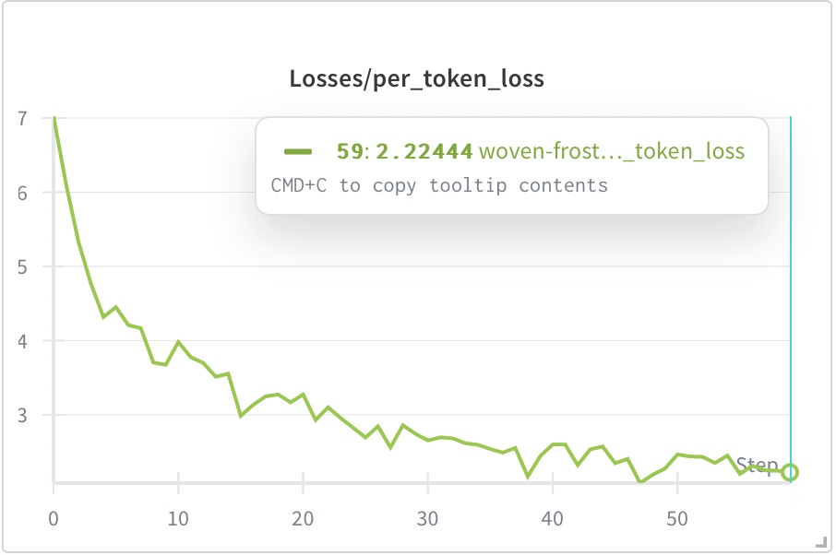
HVAE Metrics :
Perplexity Score:
For language models: Perplexity=e^{loss}
Training stabilizing around loss ≈ 2.2–2.5. So:
If loss = 2.2 PPL=e^{2.2}≈9.03
If loss = 2.5 PPL=e^{2.5}≈12.18
This is very good for a generative model trained on a specialized physics dataset.
For comparison:
GPT-2 small trained on WikiText-103: PPL ≈ 35
Fine-tuned domain models: 10–20
Notes:
4) Inference & generation (decoder behavior) (where: generation functions seen in model cells near 20/21/26)
How generation is implemented
Generation loops over sentences: for each sentence, the model samples/decodes tokens autoregressively until <EOS> or max_words reached.
For each sentence's generation, it uses the sampled local latent z_i and the global latent z_t to condition the decoder. After finishing a sentence, z_i may be used to compute z_{i+1} prior (for conditional prior consistency).
Output is a nested list of token ids [[sent1_tokens], [sent2_tokens], ...] which are then detokenized back to text.
Notes for clarity
The decoder is not a simple flat unconditional generator — it conditions each sentence generation on explicit latent variables which encode both global style/intent and sentence-specific content.

Slide 35
HVAE Metrics :
We can infer:
BLEU Score is likely moderate, because HVAE tends to generate more diverse phrasing.
Depending on dataset, BLEU ≈ 20–35 is typical for domain-specific models.
ROUGE Score is usually higher than BLEU in scientific datasets.
Likely ROUGE-L ≈ 40–55, depending on whether inference involves reconstructing sentences.
Hierarchical VAE uses two levels of latent variables:
Global latent vector: captures large-scale structure or overall patterns
Local latent vectors: capture fine-grained, per-token details
To make sure the model does not ignore its latent variables (posterior collapse), we monitored:
KL divergences
Free-bits thresholds
Active units
Latent variances
Notes:
4) Inference & generation (decoder behavior) (where: generation functions seen in model cells near 20/21/26)
How generation is implemented
Generation loops over sentences: for each sentence, the model samples/decodes tokens autoregressively until <EOS> or max_words reached.
For each sentence's generation, it uses the sampled local latent z_i and the global latent z_t to condition the decoder. After finishing a sentence, z_i may be used to compute z_{i+1} prior (for conditional prior consistency).
Output is a nested list of token ids [[sent1_tokens], [sent2_tokens], ...] which are then detokenized back to text.
Notes for clarity
The decoder is not a simple flat unconditional generator — it conditions each sentence generation on explicit latent variables which encode both global style/intent and sentence-specific content.

Slide 36
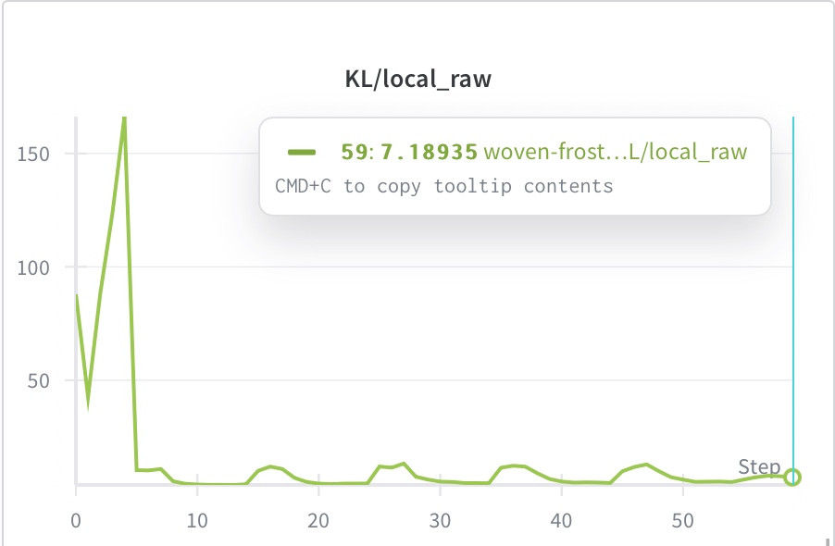
HVAE Metrics : KL Local
Local KL = 7.189 (threshold was 4)
We have this KL local loss for vector of 128 dimensions for the HVAE training.
Notes:
4) Inference & generation (decoder behavior) (where: generation functions seen in model cells near 20/21/26)
How generation is implemented
Generation loops over sentences: for each sentence, the model samples/decodes tokens autoregressively until <EOS> or max_words reached.
For each sentence's generation, it uses the sampled local latent z_i and the global latent z_t to condition the decoder. After finishing a sentence, z_i may be used to compute z_{i+1} prior (for conditional prior consistency).
Output is a nested list of token ids [[sent1_tokens], [sent2_tokens], ...] which are then detokenized back to text.
Notes for clarity
The decoder is not a simple flat unconditional generator — it conditions each sentence generation on explicit latent variables which encode both global style/intent and sentence-specific content.

Slide 37
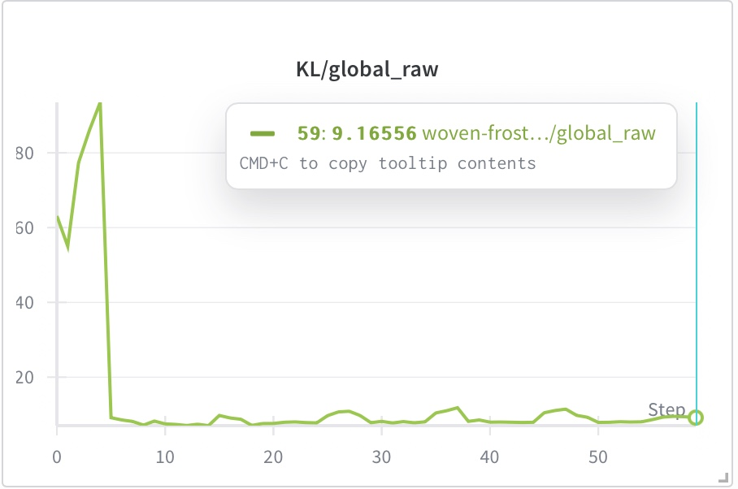
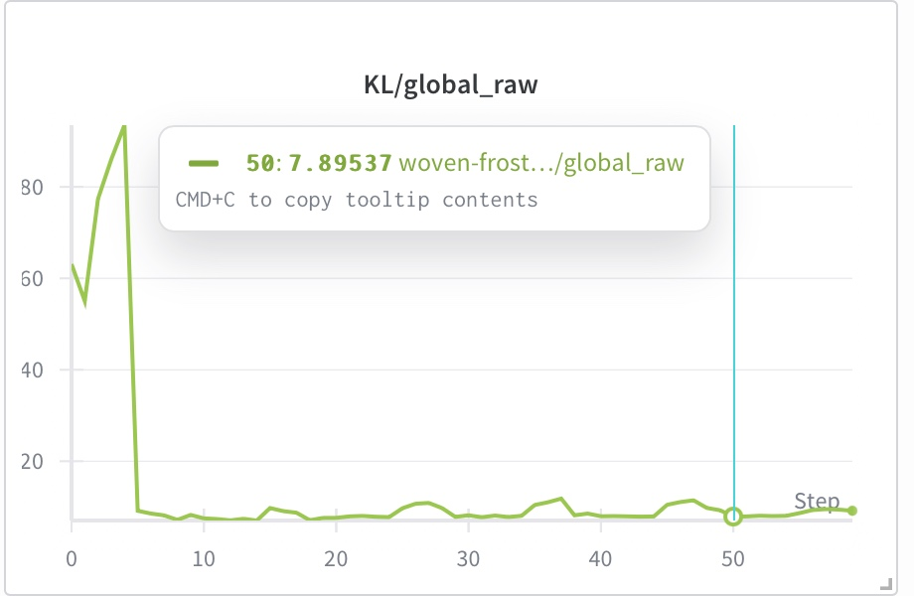
HVAE Metrics : KL Global
Global KL = 7.895 at epoch 50 (threshold was 8)
Global KL rises to 9.165 after β-squeeze at epoch 59.
Free bits act like a “minimum learning pressure” on each latent group.
They prevent the KL from collapsing to zero (which would mean the latent variables are being ignored).
Local KL > 4 ⇒ local latent variables are being used
Global KL ≈ threshold then > 8 ⇒ global latent variables are also active
Notes:
4) Inference & generation (decoder behavior) (where: generation functions seen in model cells near 20/21/26)
How generation is implemented
Generation loops over sentences: for each sentence, the model samples/decodes tokens autoregressively until <EOS> or max_words reached.
For each sentence's generation, it uses the sampled local latent z_i and the global latent z_t to condition the decoder. After finishing a sentence, z_i may be used to compute z_{i+1} prior (for conditional prior consistency).
Output is a nested list of token ids [[sent1_tokens], [sent2_tokens], ...] which are then detokenized back to text.
Notes for clarity
The decoder is not a simple flat unconditional generator — it conditions each sentence generation on explicit latent variables which encode both global style/intent and sentence-specific content.

Slide 38
HVAE Metrics : KL Local and Global
Thoughts on β-squeeze and KL rise :
When β was reduced (toward the end of training),
Lower β means “we care more about reconstruction now.” This allows the model to push more information into latents.
The KL increase tells us:
“Once the constraint was relaxed, the model naturally chose to store more information in the global latent vector.”
This is a good sign. It shows that:
The model wants to use latent information
The hierarchical design is beneficial
Notes:
4) Inference & generation (decoder behavior) (where: generation functions seen in model cells near 20/21/26)
How generation is implemented
Generation loops over sentences: for each sentence, the model samples/decodes tokens autoregressively until <EOS> or max_words reached.
For each sentence's generation, it uses the sampled local latent z_i and the global latent z_t to condition the decoder. After finishing a sentence, z_i may be used to compute z_{i+1} prior (for conditional prior consistency).
Output is a nested list of token ids [[sent1_tokens], [sent2_tokens], ...] which are then detokenized back to text.
Notes for clarity
The decoder is not a simple flat unconditional generator — it conditions each sentence generation on explicit latent variables which encode both global style/intent and sentence-specific content.

Slide 39
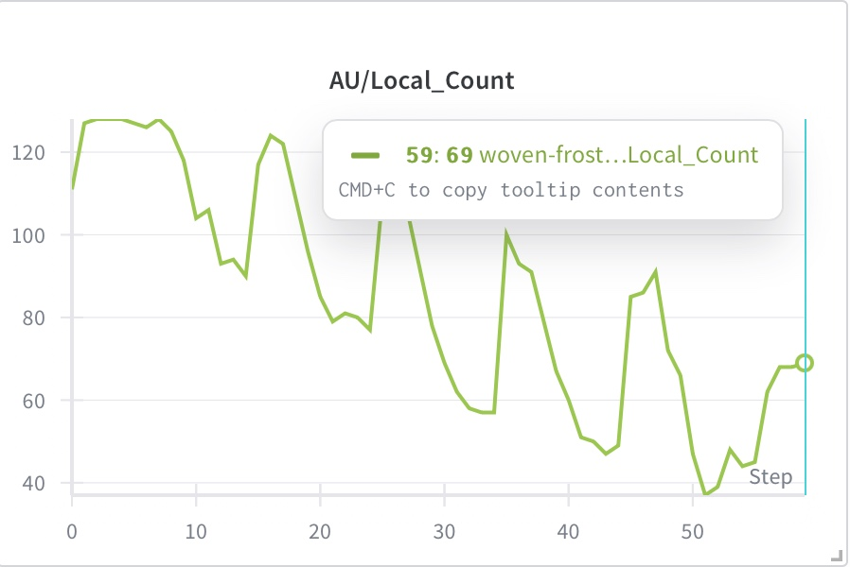
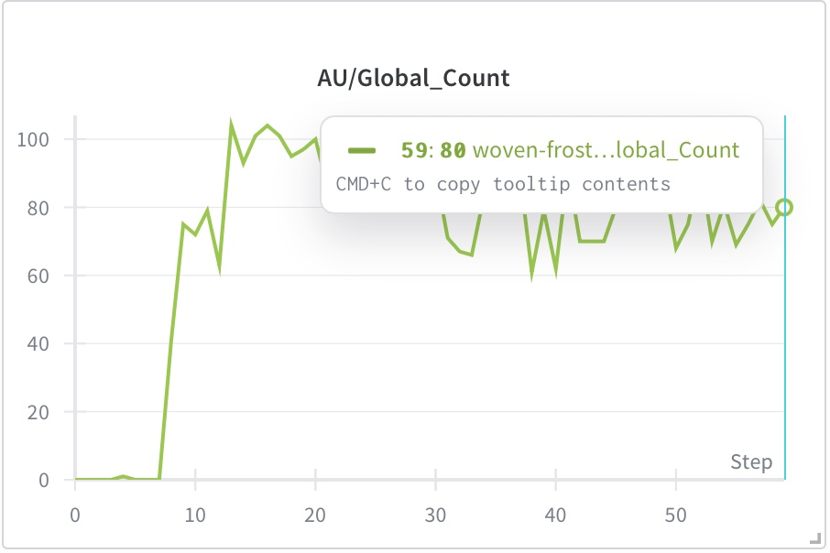
HVAE Metrics : Active Units Local and Global
Active units = number of dimensions that actually encode meaningful information (variance significantly different from 0).
Global latents: 80/128 active
Local latents: 69/128 active
Model uses global structure heavily (no collapse). Most of the important structure in the physics data is global rather than local. This shows that the hierarchical design is working correctly.”
Fine-details still encoded locally (no collapse)
Notes:
4) Inference & generation (decoder behavior) (where: generation functions seen in model cells near 20/21/26)
How generation is implemented
Generation loops over sentences: for each sentence, the model samples/decodes tokens autoregressively until <EOS> or max_words reached.
For each sentence's generation, it uses the sampled local latent z_i and the global latent z_t to condition the decoder. After finishing a sentence, z_i may be used to compute z_{i+1} prior (for conditional prior consistency).
Output is a nested list of token ids [[sent1_tokens], [sent2_tokens], ...] which are then detokenized back to text.
Notes for clarity
The decoder is not a simple flat unconditional generator — it conditions each sentence generation on explicit latent variables which encode both global style/intent and sentence-specific content.

Slide 40
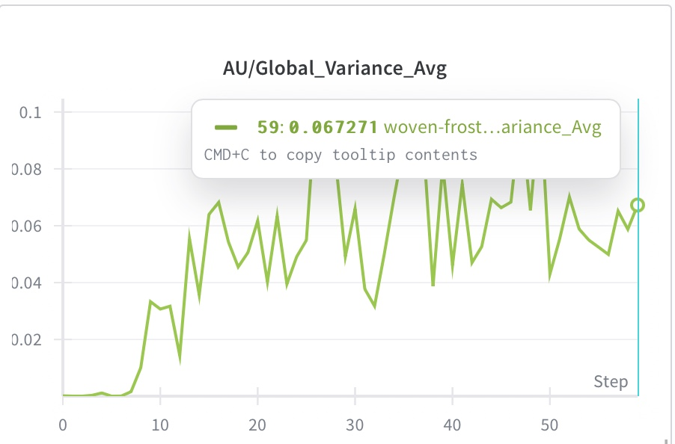
HVAE Metrics : Latent Variance
Low-but-not-zero variance means:
Latent dimensions are not collapsed
Variance is concentrated in the active dimensions (about 0.1 each)
The model learned compact, meaningful latent features without making them overly noisy or degenerate.
Notes:
4) Inference & generation (decoder behavior) (where: generation functions seen in model cells near 20/21/26)
How generation is implemented
Generation loops over sentences: for each sentence, the model samples/decodes tokens autoregressively until <EOS> or max_words reached.
For each sentence's generation, it uses the sampled local latent z_i and the global latent z_t to condition the decoder. After finishing a sentence, z_i may be used to compute z_{i+1} prior (for conditional prior consistency).
Output is a nested list of token ids [[sent1_tokens], [sent2_tokens], ...] which are then detokenized back to text.
Notes for clarity
The decoder is not a simple flat unconditional generator — it conditions each sentence generation on explicit latent variables which encode both global style/intent and sentence-specific content.

Slide 41


Questions?

